Slide 1


Continuous Integration

Slide 2



Course : Mastering DevOps
Lecture On : Continuous Integration
Instructor: Dipesh Garg

Slide 3
Continuous Integration
3

Slide 4
Continuous Integration: A Recap
Continuous Integration (CI) is a development practice that requires developers to integrate code into a shared repository several times a day. Each check-in is then verified by an automated build, thereby allowing teams to detect problems early
By integrating code regularly, you can detect errors quickly, and locate them more easily
thoughtworks.com
“Continuous Integration doesn’t get rid of bugs, but it does make them dramatically easier to find and remove”
Martin Fowler
Chief Scientist, ThoughtWorks

Slide 5
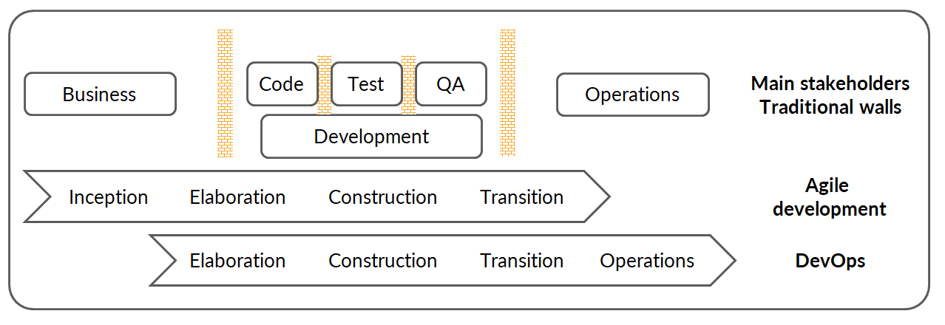
Drawbacks of Traditional SDLC
Agile breaks down the wall between the Business and Development teams
DevOps breaks down the wall between the Development and Operations teams
DevOps centres on the concept of sharing (ideas, issues, processes, tools and goals)

Slide 6


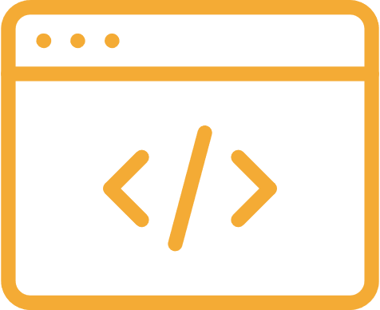
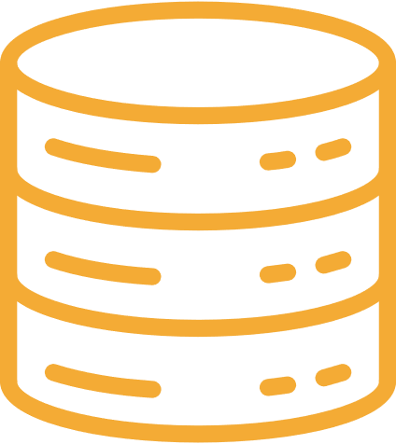

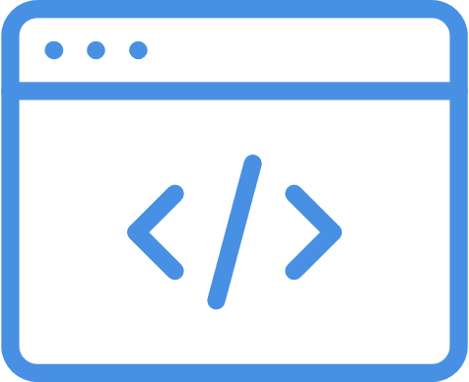
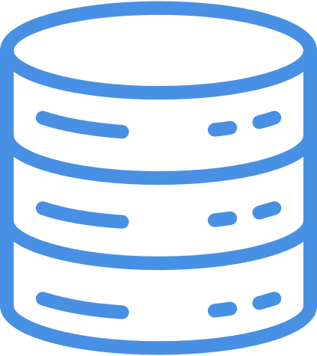
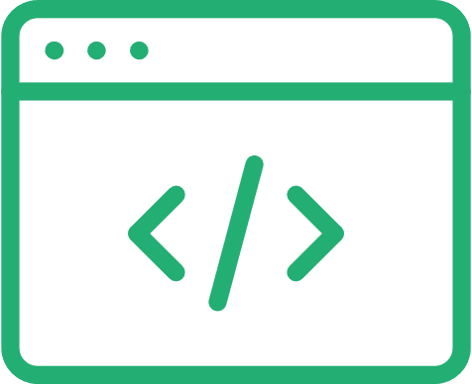
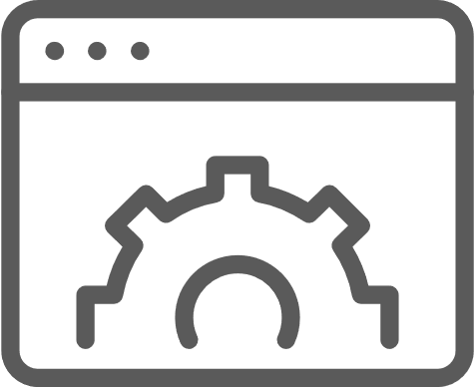
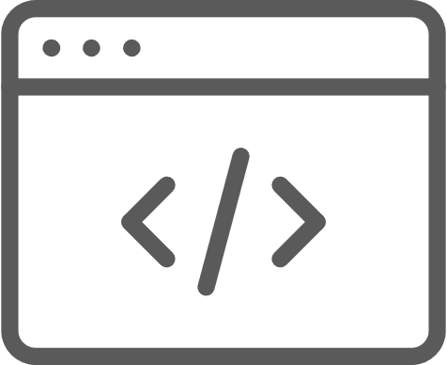
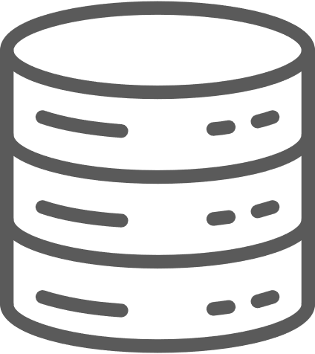
Old School Integration: Before CI was Introduced
Build &
Integration Team
Customer
Profile
Product
Catalog
Integrate
Compile
Package
Order
Tracking

Slide 7
Old School Integration: Pain Points
Issues with software roll-out when Continuous Integration is not used:
(Code) Integration is painful and requires effort
Fixing issues at the end of iterations
Intermediate merge issues can hold up teams
Long feedback cycle for functional defects
Long iterations

Slide 8
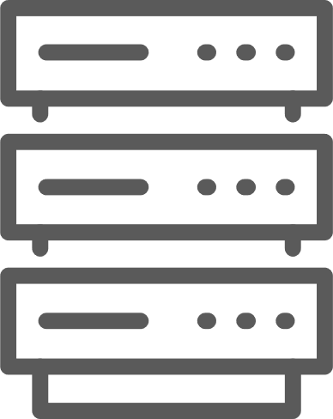
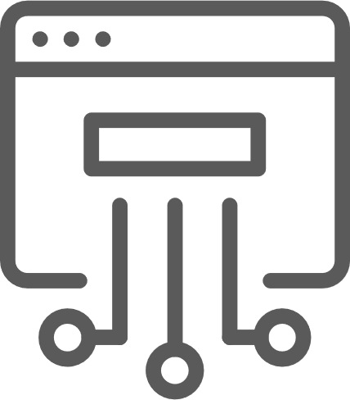

Implementing Continuous Integration
How does Continuous Integration help in fixing the pain points?
Build &
Integration Team
Customer
Profile
Master
Compile
Package
Automated
unit tests
Automated
UI tests
Product
Catalog
Order
Tracking

Slide 9
Benefits of Introducing Continuous Integration
Reduced risk
Increased confidence
Better quality code
Ready-to-ship code
Systematic versioning
Code quality trend analysis
Time taken for marketing
Reduced cost

Slide 10
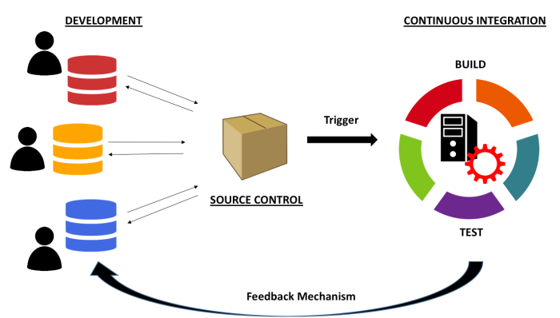
Continuous Integration: Summary

Slide 11
Principles of Continuous Integration
A single central repository where the code is stored.
Developers check in or commit their code frequently
Build should be triggered every time a developer checks in code
Build should be automated and fast
Build should compile the code as well as run automated test suites
Fixing a failed build should be the top priority for developers
Build results should always be communicated to all developers

Slide 12
Continuous Integration Phases
12

Slide 13
Continuous Integration Phases
Unit Testing
Compilation and Packaging
Continuous Testing
Code Review (Static Code Analysis)
Artifact Repository

Slide 14
Unit Testing
What is Unit Testing?
Why do we need to perform unit testing?
Some popular testing tools

Slide 15

What Is Unit Testing?
Unit Testing is a software testing method by which individual units of source code—sets of one or more computer program modules together with associated control data, usage procedures, and operating procedures—are tested to determine whether they are fit for use
Wikipedia

Slide 16
Unit Testing: Why Do It?
Improves the quality of code
Goes hand in hand with Agile processes
Helps to find software bugs early
Helps to understand the design in a better manner
Reduces ‘Technical Debt’
Dzone DevOps Zone

Slide 17






Some Popular Unit Testing Tools

Slide 18
Compilation and Packaging
Automated software builds that can be triggered from the command line are an essential and integral part of any CI pipeline
A modern full-fledged automated build tool should have the following capabilities among others:
Initialising the environment
Compiling source code
Setting up test data
Compiling and running tests
Building Artifact for delivery/deployment
Examples of build tools: Make (C/C++), Rake (Rails), MSBuild and NAnt (.Net) and Ant, Maven, Gradle (Java), etc.

Slide 19
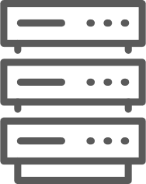


Compilation and Packaging
Flow diagram explaining how compilation and packaging is being run by CI server
Fetch Changes
Code
Checkins
Build Notifications

Slide 20
Static Code Analysis
Definition
Static code analysis (also known as Source Code Analysis) is a method of debugging by examining source code before a program is run. This is done by analysing a set of code against a set (or multiple sets) of coding rules
Some of the common techniques are Taint Analysis and Data flow Analysis
Taint Analysis
Taint analysis is an analysis that detects any injection vulnerability pattern in source code. The analysis identifies the information flow of untrustworthy input that affects the sensitive sink or part of the system
Data Flow Analysis:
Data flow testing is a testing strategy that focuses on the data variables and their values, used in the programming logic of the software product, by making use of the control flow graph. Data flow testing is a form of white box testing and structural type testing that generally keeps check at the points where the data values are being received by the variables and at the points when it is called for use.

Slide 21
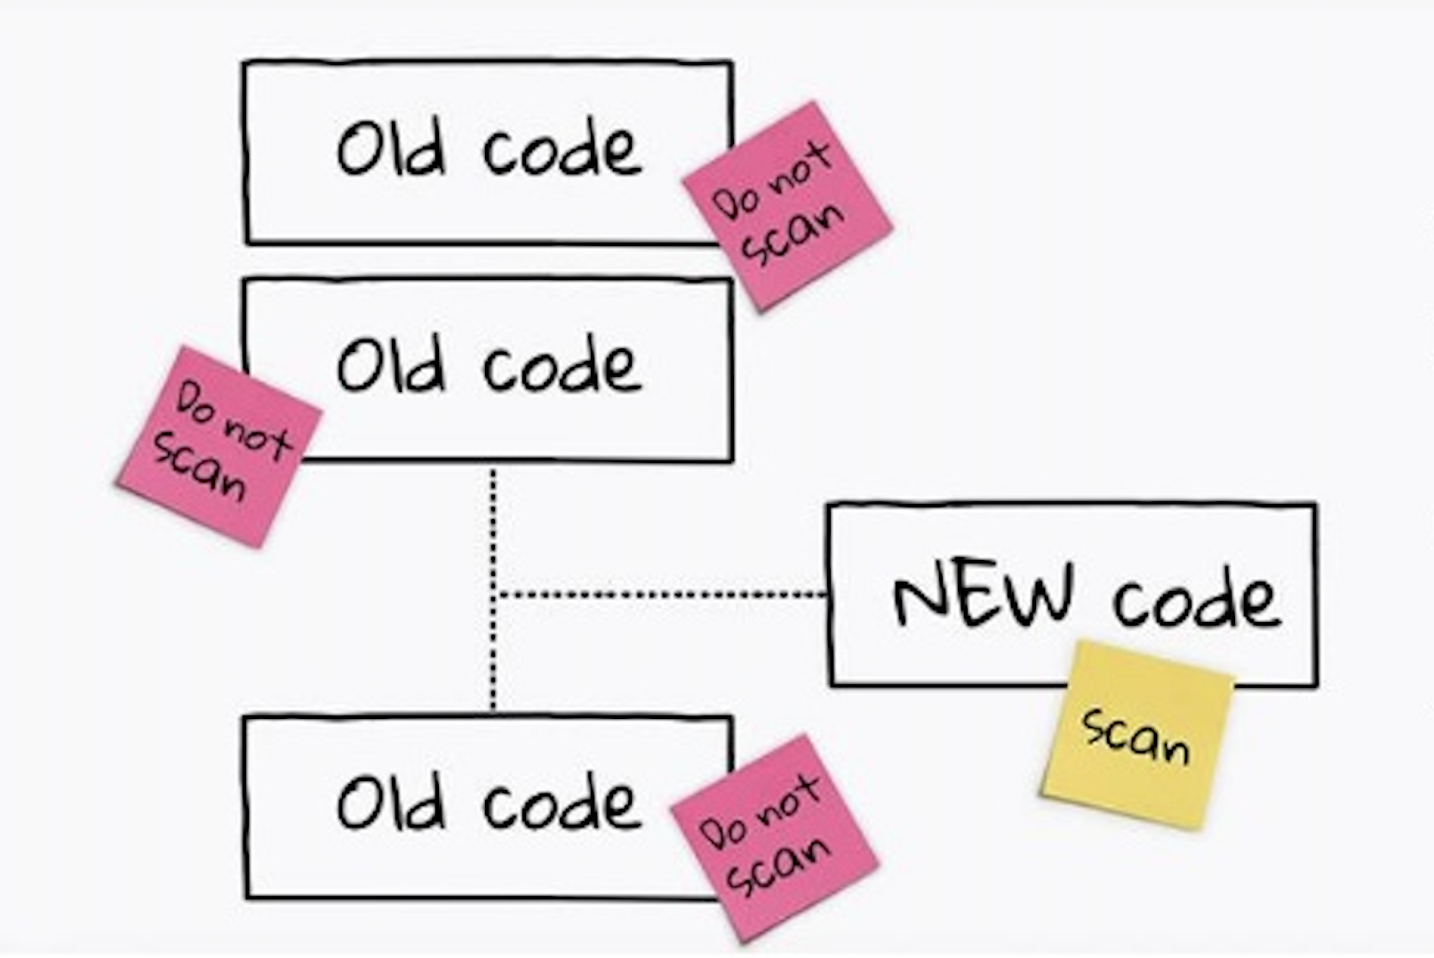
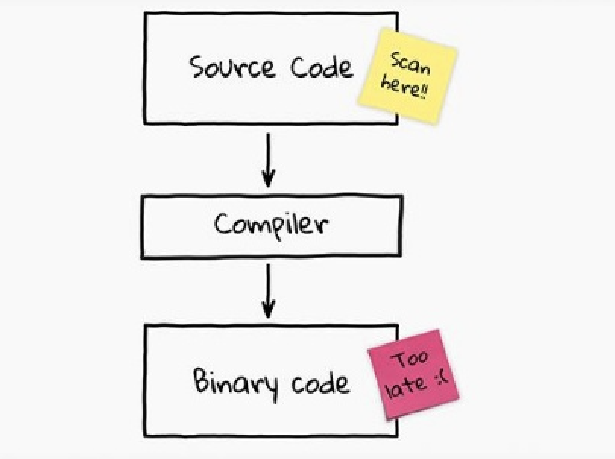
Benefits of Static Code Analysis
Evaluation of full source code, which increases the code quality
Typically done using automated tools, making it less prone to human error
Much faster than other methods of code review mechanisms
More cost-effective than pair programming
Incremental scan capability only analyses new or modified code
No dependencies need to be configured. You just throw at it!

Slide 22
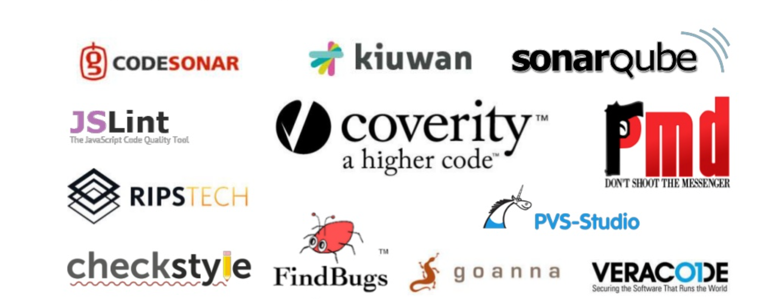
Static Code Analysis: Popular Tools

Slide 23
Artifact Repository
One of the main objective of a fully integrated CI system is to generate the bundled software artifacts with the latest code changes and make it available for Continuous Delivery or Continuous Deployment pipelines
For this purpose, we generally need an Artifact Repository software, which typically acts as an output location for a CI workflow and an input location for a CD workflow
An Artifact Repository is sometimes also referred to as Artifact Management Tools.
Artifact repositories make:
    Dependency management easier
    Releases more stable
    Audit easier and more feasible

Slide 24
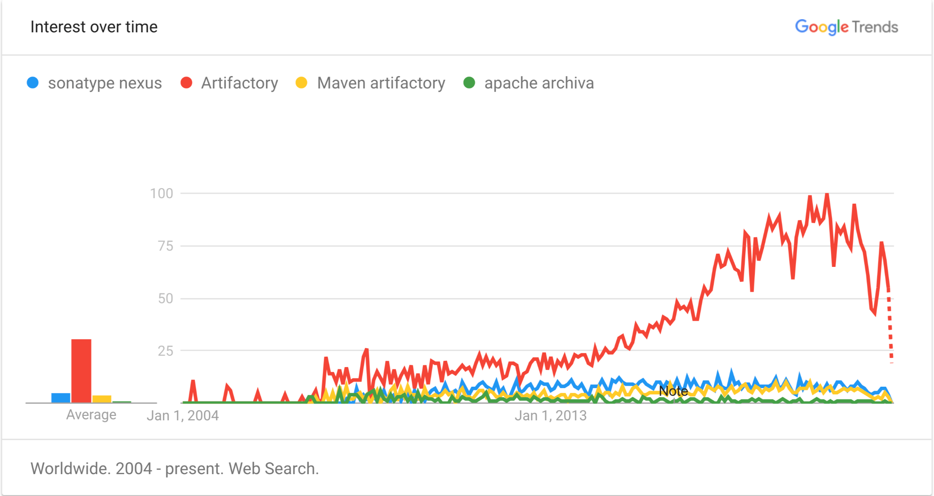
Popular Artifact Repositories
Sonatype Nexus
Jfrog Artifactory
Maven Artifact Repository
Apache Archiva

Slide 25
Introduction to Jenkins

Slide 26

Jenkins – An Introduction
Jenkins is basically a free and open-source automation server.
Jenkins can be used to automate all types of software development tasks such as building, testing, and delivering or deploying software.
Jenkins can be installed via native system packages, Docker, or it can be run standalone on any computer.

Slide 27
Features of Jenkins
Jenkins, originally called Hudson, is an open-source CI tool written in Java.
Jenkins is a very user-friendly tool, with a simple, intuitive and visually appealing user interface.
Jenkins has a very low learning curve.
Jenkins is an extremely flexible tool and hundreds of open-source plugins are available, with more coming up every week.

Slide 28
Features of Jenkins
These plugins cover everything from version-control systems, build tools, code quality metrics and build notifiers to integration with external systems, UI customisations, and much more.
The Jenkins community is a large, dynamic, reactive and welcoming bunch, with passionate champions, active mailing lists, IRC channels and a very vocal blog and Twitter account.
The pace of development is quite fast, with the latest new features, bug fixes, and plugin updates being released on a weekly basis.
Jenkins is a JAVA application, so it is platform independent.

Slide 29
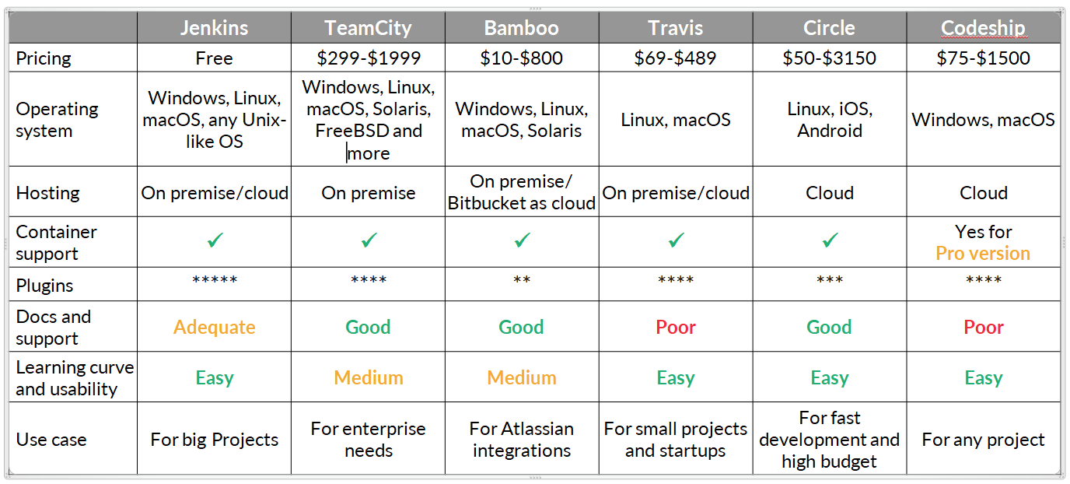
Comparison of CI Tools

Slide 30
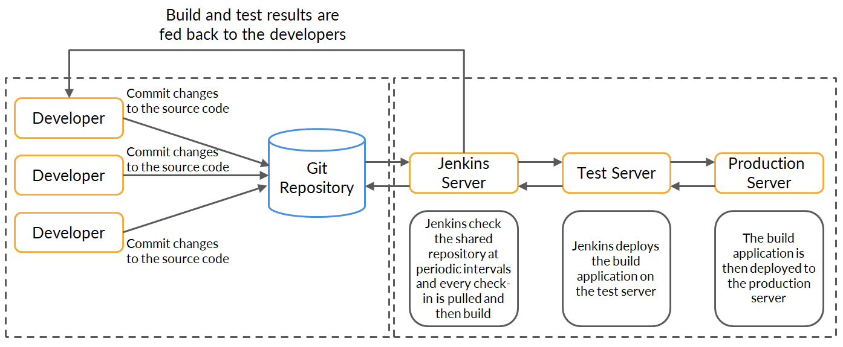
Jenkins Architecture

Slide 31
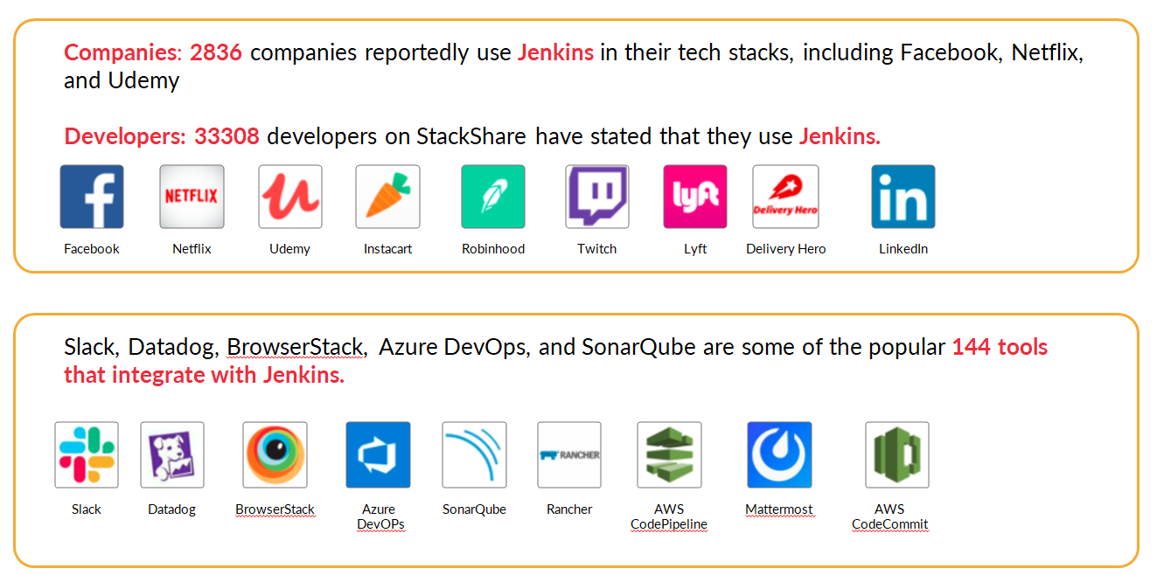
Companies That Use Jenkins

Slide 32
Configuring and Setting Up Jenkins

Slide 33
Jenkins Installation – The Step-by-Step Procedure
Install Java
sudo apt install openjdk-11-jdk
To check java –version
openjdk 11.0.10 2021-01-19
OpenJDK Runtime Environment (build 11.0.10+9-Ubuntu-0ubuntu1.18.04)
OpenJDK 64-Bit Server VM (build 11.0.10+9-Ubuntu-0ubuntu1.18.04, mixed mode, sharing)
Install Jenkins
wget -q -O - https://pkg.jenkins.io/debian-stable/jenkins.io.key | sudo apt-key add -
sudo sh -c 'echo deb https://pkg.jenkins.io/debian-stable binary/ /etc/apt/sources.list.d/jenkins.list'
sudo apt-get update
sudo apt-get install jenkins
To check Jenkins version: vim /var/lib/jenkins/config.xml
<version>2.263.4</version>

Slide 34
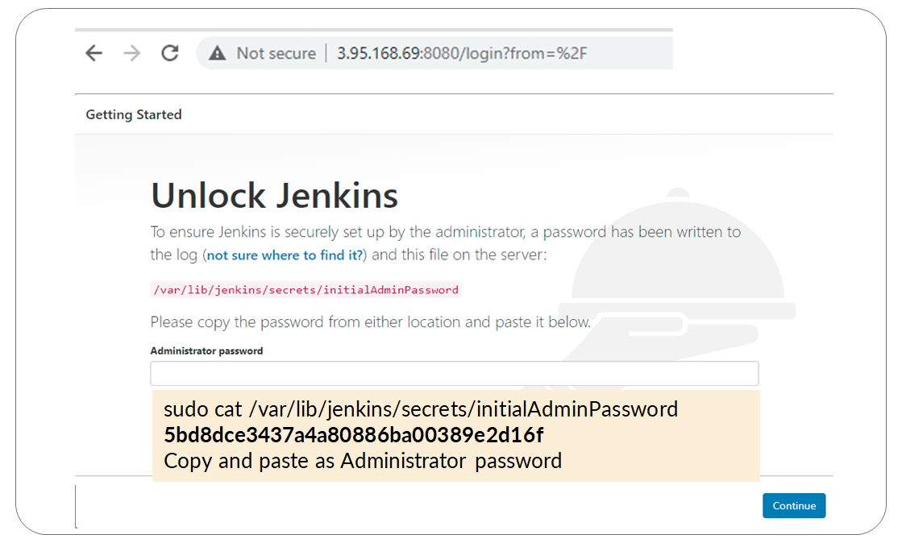
Execute https://<ipaddress>:8080

Slide 35
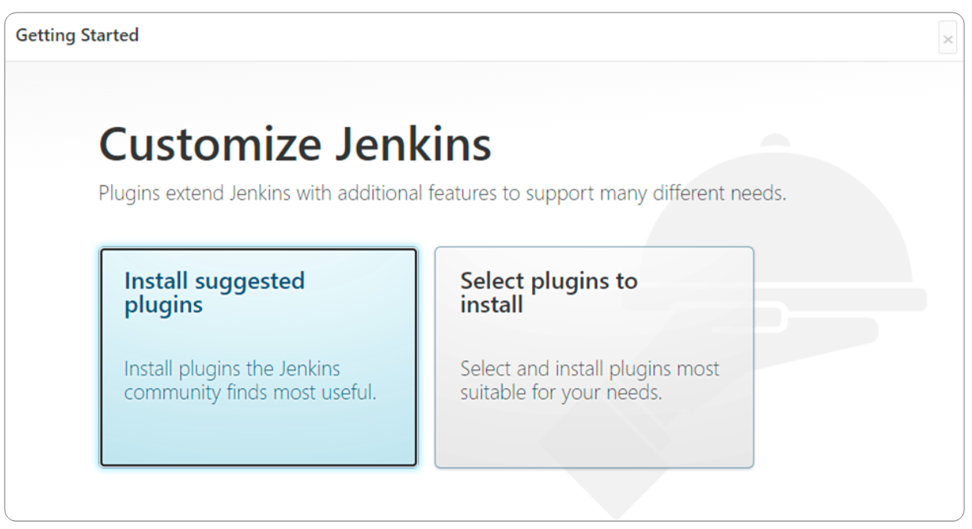
Installation of Default Plugins

Slide 36
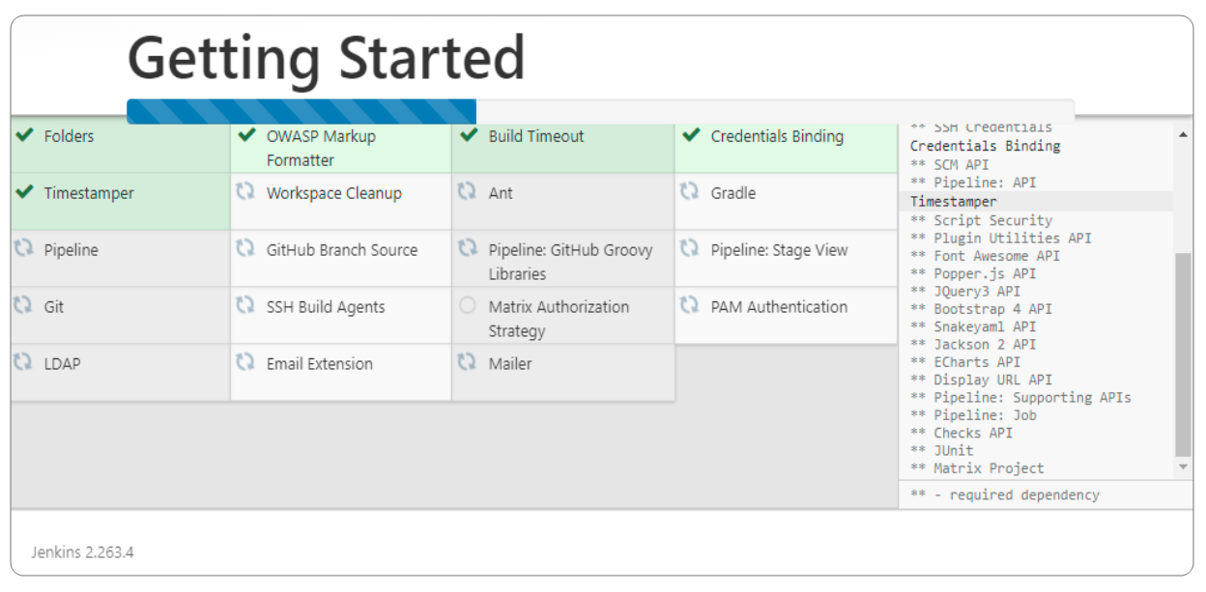
Install Suggested Plugins

Slide 37
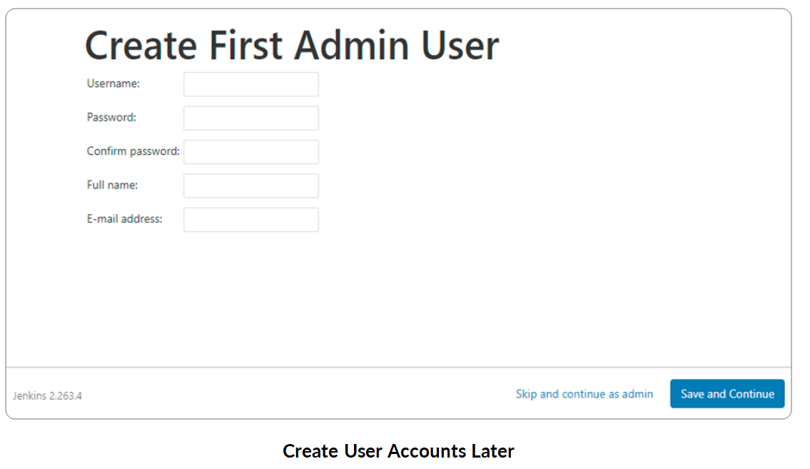
Continue as Admin

Slide 38
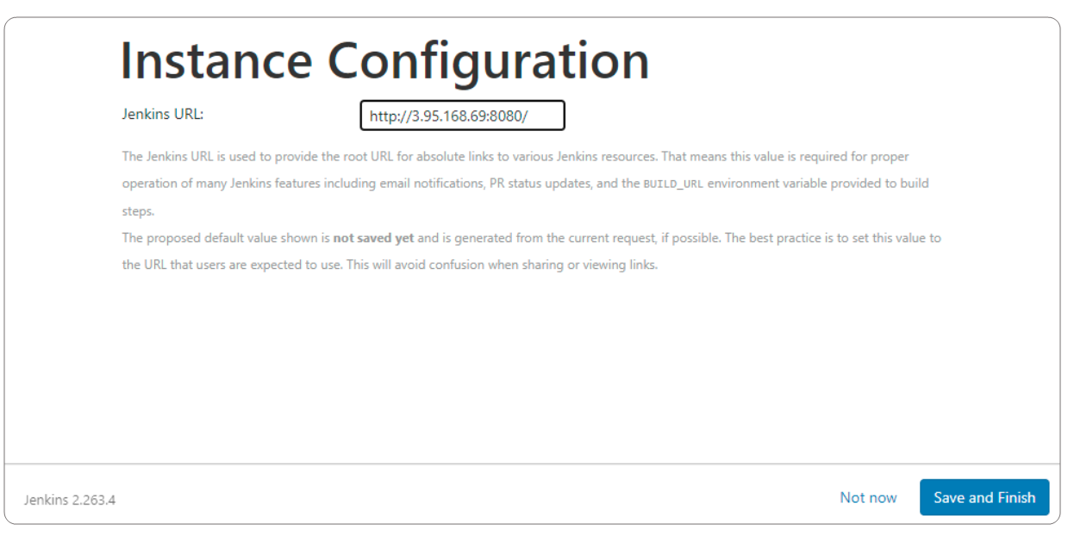
Save Jenkins Configuration

Slide 39
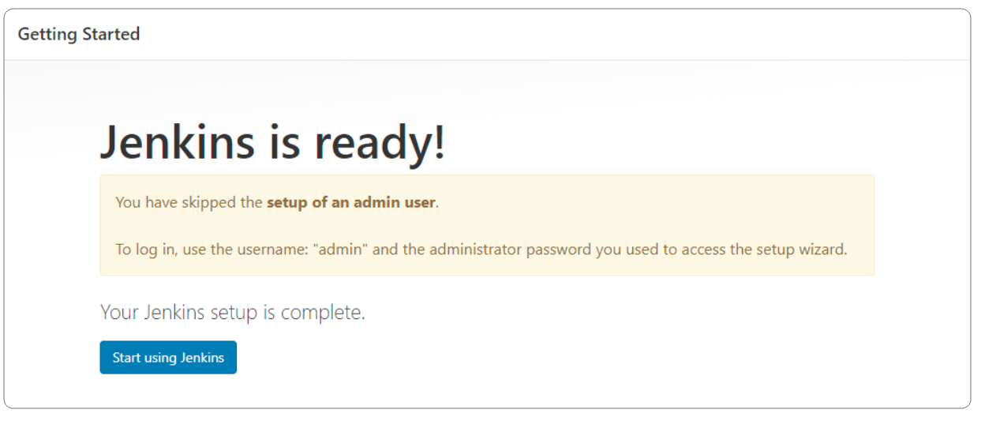
Start Jenkins

Slide 40
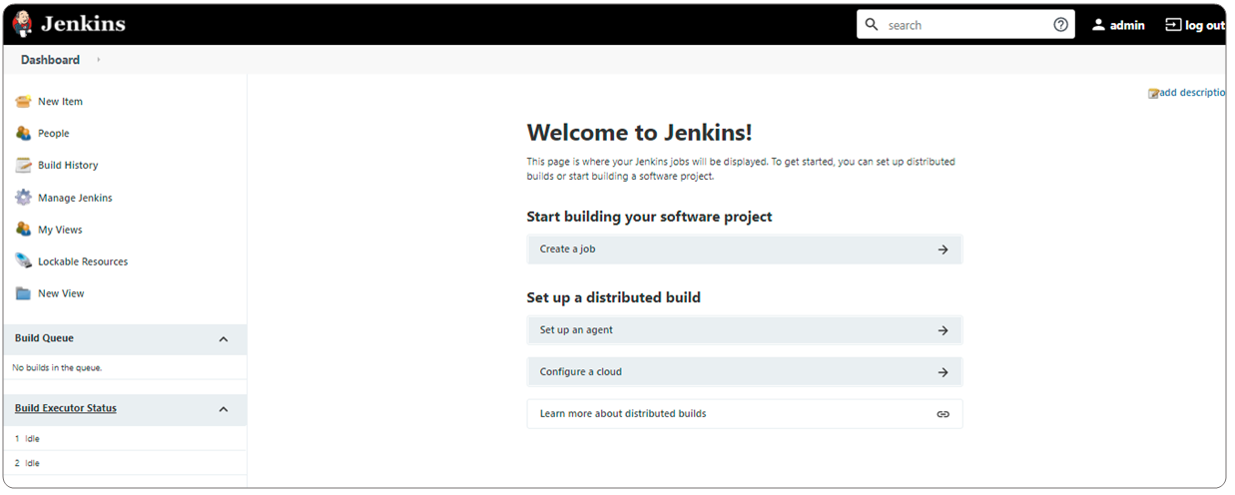
Jenkins Dashboard

Slide 41
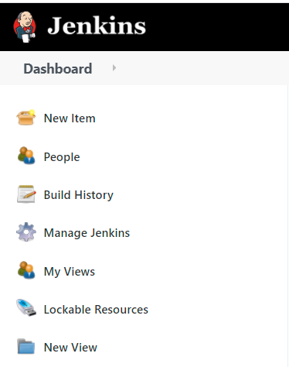
Dashboard – Various Options

Slide 42
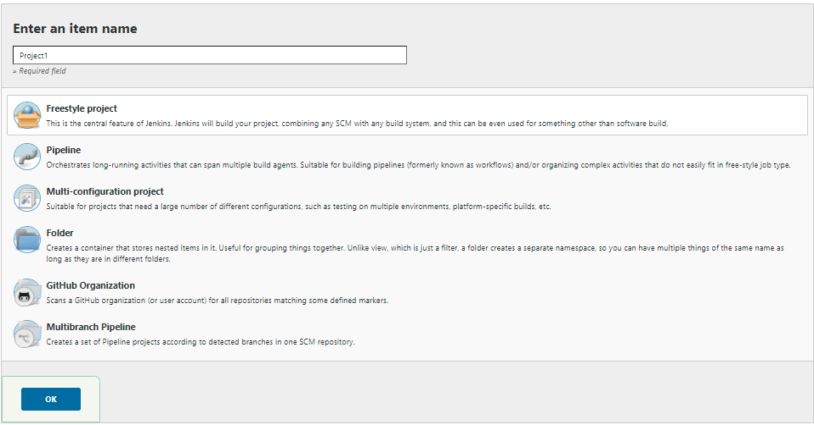
Select New Item

Slide 43


Poll 1 (15 seconds)
Jenkins default admin password can be found at:
/var/lib/jenkins/secrets/InitialAdminPassword
/etc/passwd | grep admin
/var/lib/Jenkins/secrets/InitialAdminPassword
/var/lib/Jenkins/secrets/passwd
Practice in teams of 4 students
Industry expert mentoring to learn better
Get personalised feedback for improvements
43

Slide 44
Poll 1 (15 seconds)
Jenkins default admin password can be found at:
/var/lib/jenkins/secrets/InitialAdminPassword
/etc/passwd | grep admin
/var/lib/Jenkins/secrets/InitialAdminPassword
/var/lib/Jenkins/secrets/passwd
Practice in teams of 4 students
Industry expert mentoring to learn better
Get personalised feedback for improvements
44

Slide 45
Understand How to Create Jobs in Jenkins

Slide 46
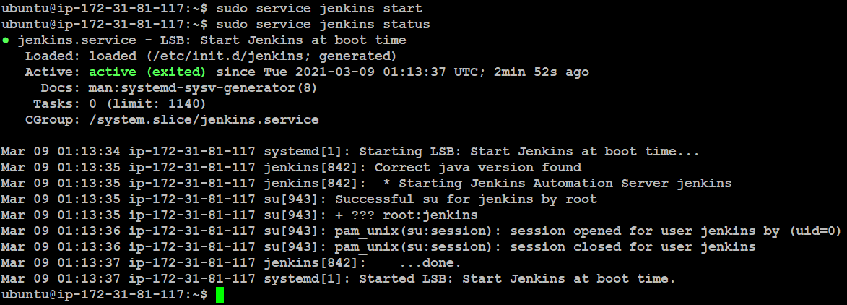
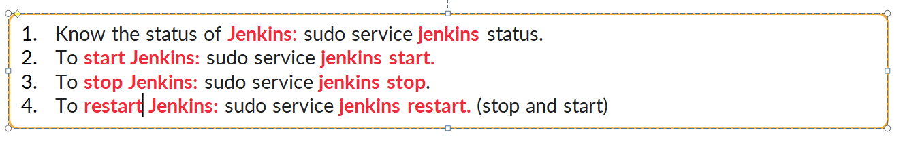
Start Jenkins
46

Slide 47
Jenkins Workspace
Jenkins home directory:
ubuntu@ip-172-31-81-117:~$ sudo su - jenkins
jenkins@ip-172-31-81-117:~$ pwd
/var/lib/jenkins
jenkins@ip-172-31-81-117:~$
Jenkins home directory: /var/lib/jenkins
It contains the details of the Jenkins server configuration, which is used to configure in the Manage Jenkins. The core configuration files are stored in config.xml.
It contains two important subdirectories: jobs and workspace.
Jobs directory contains configuration details of the build job in config.xml file.
Jenkins builds the given project in the workspace directory. Each project has its own directory in the workspace.

Slide 48
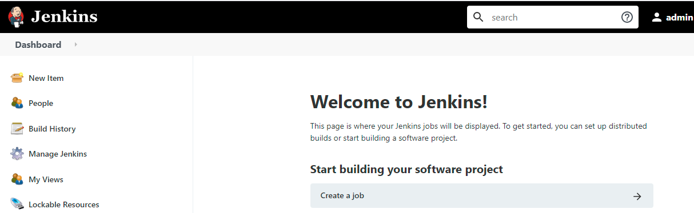
Click to Create a Job

Slide 49
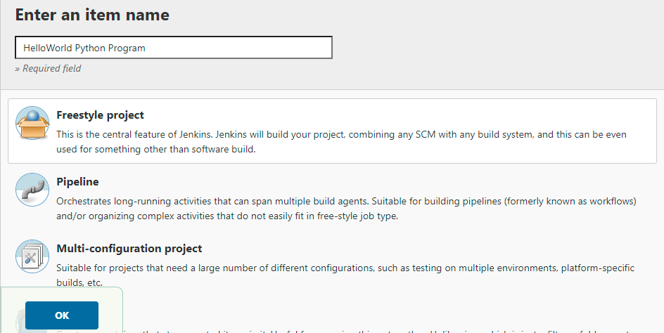
Enter Project Name and Choose Freestyle Project

Slide 50
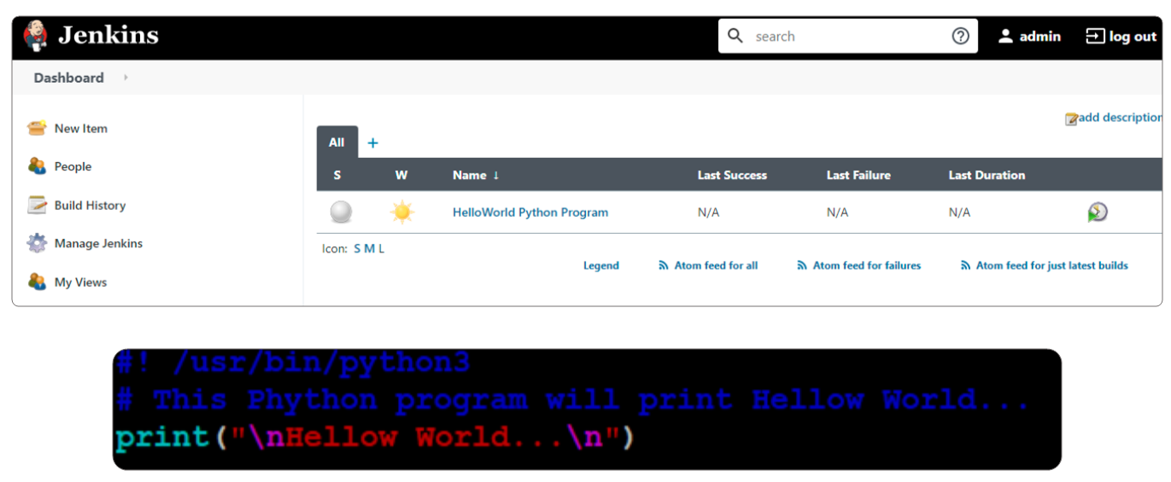
Example: HelloWorld Python Program

Slide 51
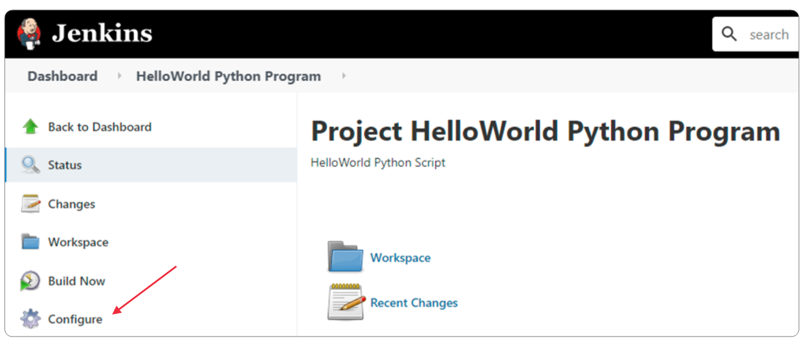
Build the Project

Slide 52
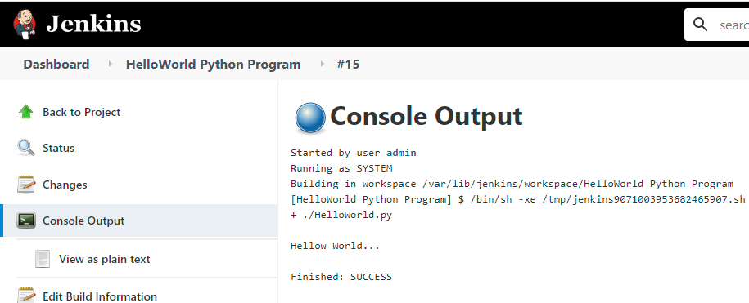
Console Output

Slide 53
Thank You!

